Slide 1
Spec Writing ENGR 297: Spring 2018
Instructor: Andrew Hu

Slide 2
Administrivia
Welcome to the software-subteam!
Attendance Link: tinyurl.com/uwigem/18sp/attendance/
Anonymous Feedback Form: tinyurl.com/uwigem/18sp/feedback/

Slide 3
Group Think Exercise
https://homes.cs.washington.edu/~mernst/pubs/groupthink-2006-2up.pdf

Slide 4
What are we doing this Spring?
Learning the fundamentals of software development
Planning our software as the project comes together from Wetlab
Writing some software

Slide 5
Class vs Team
Most classes we will act as a class
As time goes on we will have to act more like a team
Just keep in mind that we will have to work together differently based on the situation

Slide 6
What are we talking about today
Specifications
Why are we writing specs?
Activity: Let’s try to write a spec

Slide 7
What is a spec? (specification)
collection of class and method signatures
explanations of how to use that library

Slide 8
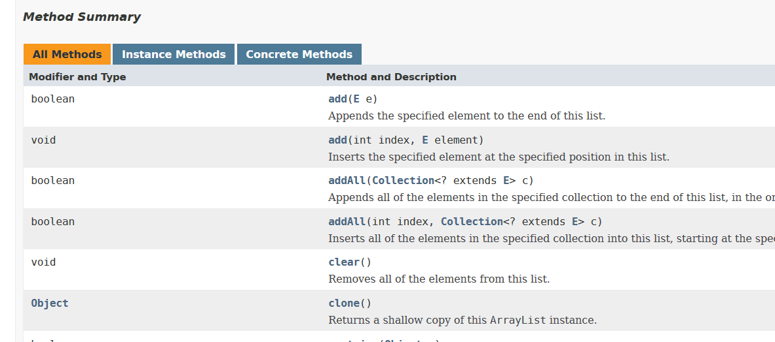
Example: Java ArrayList
method signature
description

Slide 9
How is a spec useful?
formal way to describe a library’s functionality
implementation can be changed without changing interface
hides implementation details from users

Slide 10
Why write the spec before implementing?
think through how the entire system will be used
let others write code that uses your spec, before your code is ready

Slide 11
Interface vs Implementation
Interface
How to use this library
Just the method calls
Black Box
Implementation
The actual code
Algorithms and data structures used are visible
The inner workings

Slide 12
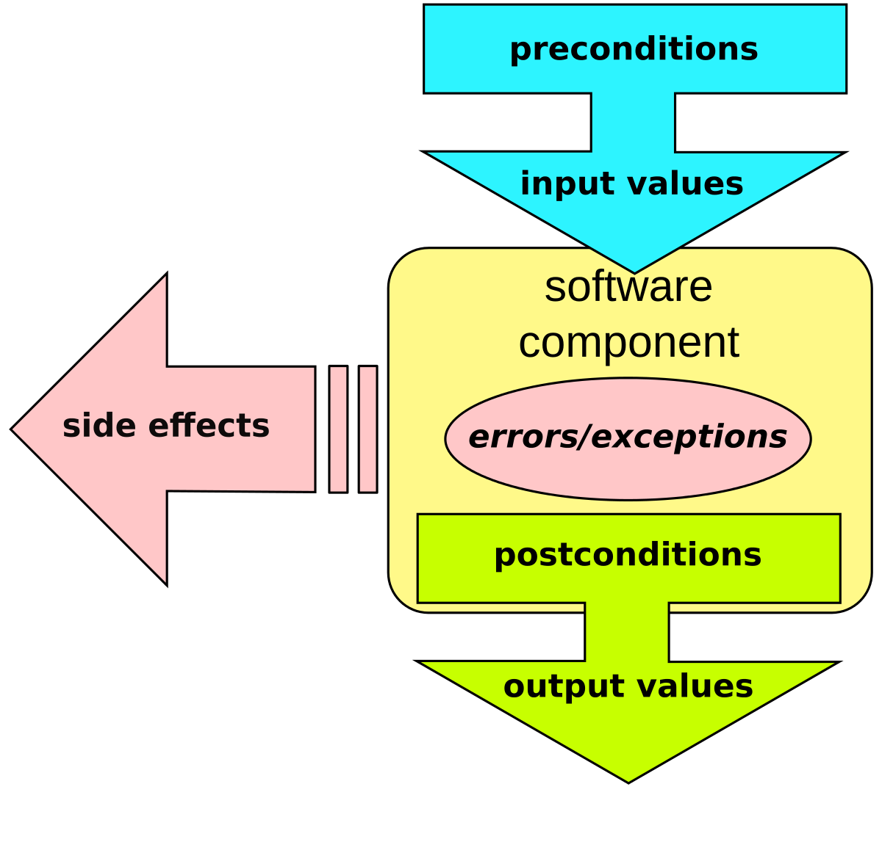
Precondition & Postcondition
Preconditions
What the user must guarantee about input
Postconditions
What the author must guarantee about output

Slide 13
Pre & Postconditions Examples
String to int converter
static int parseInt(String s){…}
Preconditions?
Postconditions?
“s” must be a valid string representation of an integer
the value returned is the int value represented by “s”

Slide 14
Undefined Behavior
Do I have to define what the behavior is when the precondition is met?
Yes!
Do I have to define what the behavior is when the precondition is not met?
No, please don’t…

Slide 15
Why should we hide the implementation?
we can edit the implementation without having to change the interface
avoid user dependency on information outside of the spec

Slide 16
The Medusa Effect
Alice’s code uses a large sorted list of data
Alice tells Bob how she has implemented this
Bob now assumes that getting the list of data in sorted order is a fast operation, and uses it frequently
Alice later decides that it is better to implement this as a hash table for better lookup times, while keeping the interface the same
Now Bob’s code is slowing down the whole system, but he has written so much of it that he can’t just delete it all
His code has been “turned to stone”

Slide 17
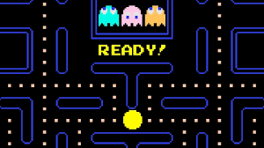
Spec Example: Pacman
Dividing up the parts

Slide 18
First Part: Parts of the Game
How can we divide up Pacman, and what interacts with what?

Slide 19
What are the parts to Pacman?
Pacman
ghosts
map and dots
graphics

Slide 20
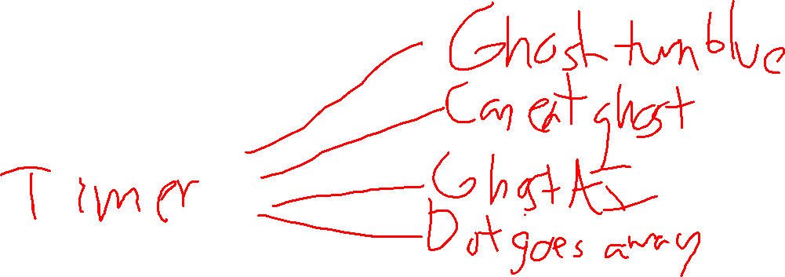
Pacman
What happens when you push the stick/arrow keys in a direction?
Does he continue to move in that direction?
What happens when he hits a wall?
What happens when he eats a big dot?

Slide 21
Ghosts
What happens when they are released?
What direction do they move?
What happens when Pacman eats a big dot?
What happens when they are eaten by Pacman?
When do they change directions?

Slide 22
Map & Dots
What happens when Pacman touches the little dots?
What happens when Pacman hits a wall?
What happens when Pacman eats a big dot?

Slide 23
Graphics
What things can you see on the screen?
What do you see when Pacman eats a dot?
What do you see when Pacman eats a big dot?
What do you see when Pacman eats a ghost?

Slide 24
Any other parts to Pacman?

Slide 25
Next Step: Specification
How would these interactions work in the code?

Slide 26

Example: Pacman and Walls
How do we stop Pacman from running through a wall?
Check for collision before updating position
Who should check? Pacman or the map?
Who has the “right” to update Pacman’s coordinates?
No on true answer
Give an argument for both sides: Pacman or the map updating coordinates

Slide 27
Activity: Brainstorming
Try to come up with an outline for a Pacman spec
Think about which part controls what
Does the map or Pacman control his coordinates?
Do Pacman and the ghosts write directly to the screen? Does it go through the map?
When updating Pacman’s position, do the dots need to be updated? Is that a separate method? If so, who owns it?

